Slide 1
Contract Monthly Claim System
Sandile Nxele : ST10230365
Enhancing Claim Submission and Processing

Slide 2
Project Overview
Purpose of the System:
Stakeholders:
Streamline the claim submission process for lecturers.
Improve processing times and accuracy of claims.
Provide a user-friendly interface for all stakeholders.
Lecturers: Submit claims efficiently and track status.
Managers: Review and approve claims with ease.
HR: Oversee the overall claim process and manage records.

Slide 3
Features
Automated Claim Submission:
Simplifies the process for lecturers to submit claims online.
Approval Workflow:
Automated notifications to managers for quick approvals.
Real-time Calculations:
Instant calculations for claim amounts based on predefined rules.
Validation Checks:
Ensures all necessary information is provided before submission.

Slide 4
Technology Stack
Backend:
ASP.NET Core: Robust framework for building web applications.
Database:
SQLite: Lightweight database for efficient data storage.
Frontend:
WPF (Windows Presentation Foundation): Provides a rich user interface for desktop applications.

Slide 5
Key Benefits
Efficiency:
Reduces time spent on manual claim processing.
Accuracy:
Minimizes human errors through automated validations.
Reduced Administrative Workload:
Frees up HR resources to focus on more strategic tasks.

Slide 6
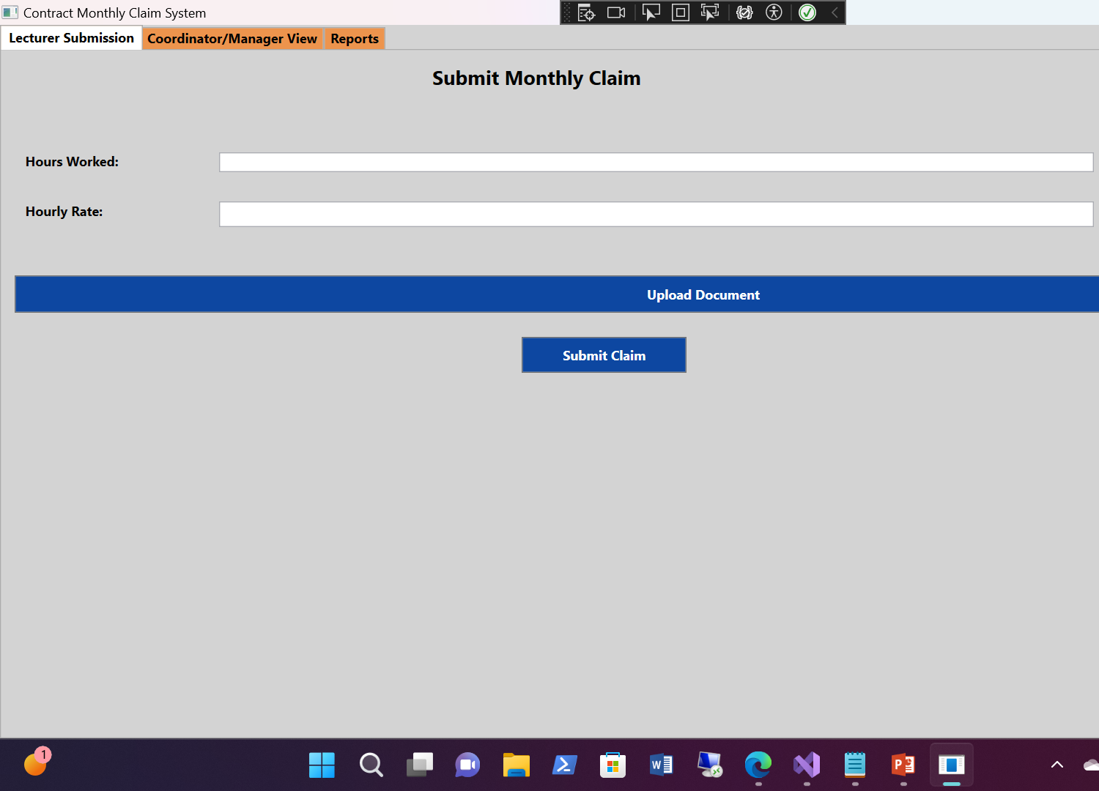
Screenshots: 1
Lecturer Submission Page:

Slide 7
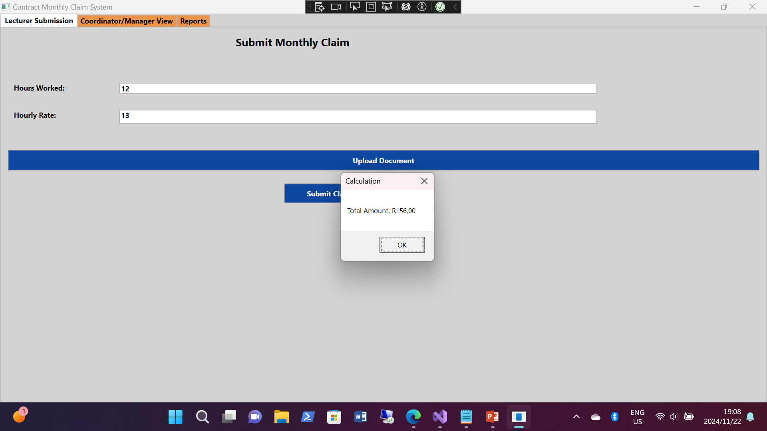
screenshots
Lecturer Submission Page:

Slide 8
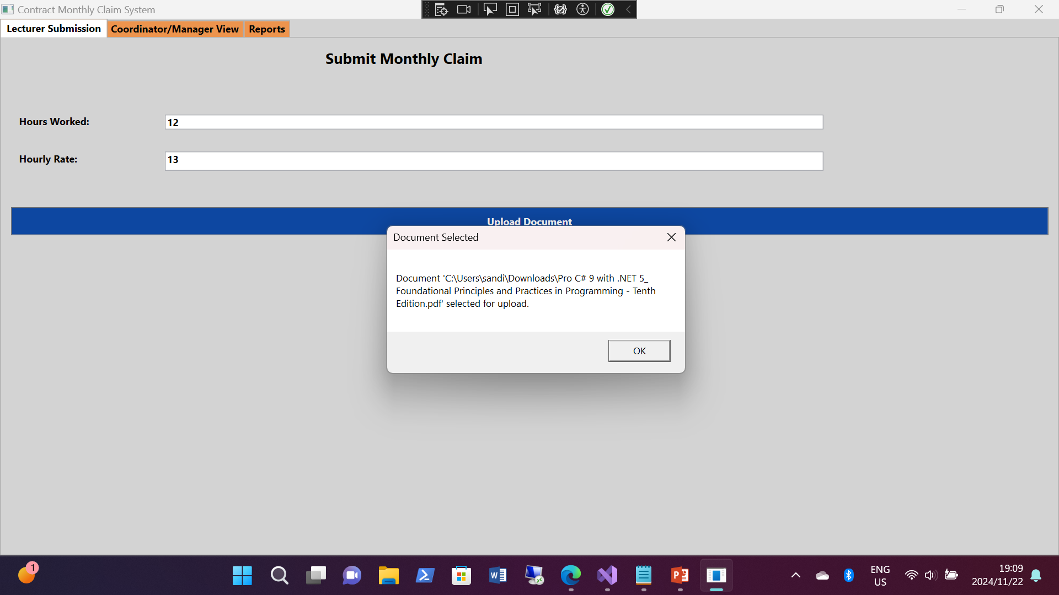
screenshots
Lecturer Submission Page:

Slide 9
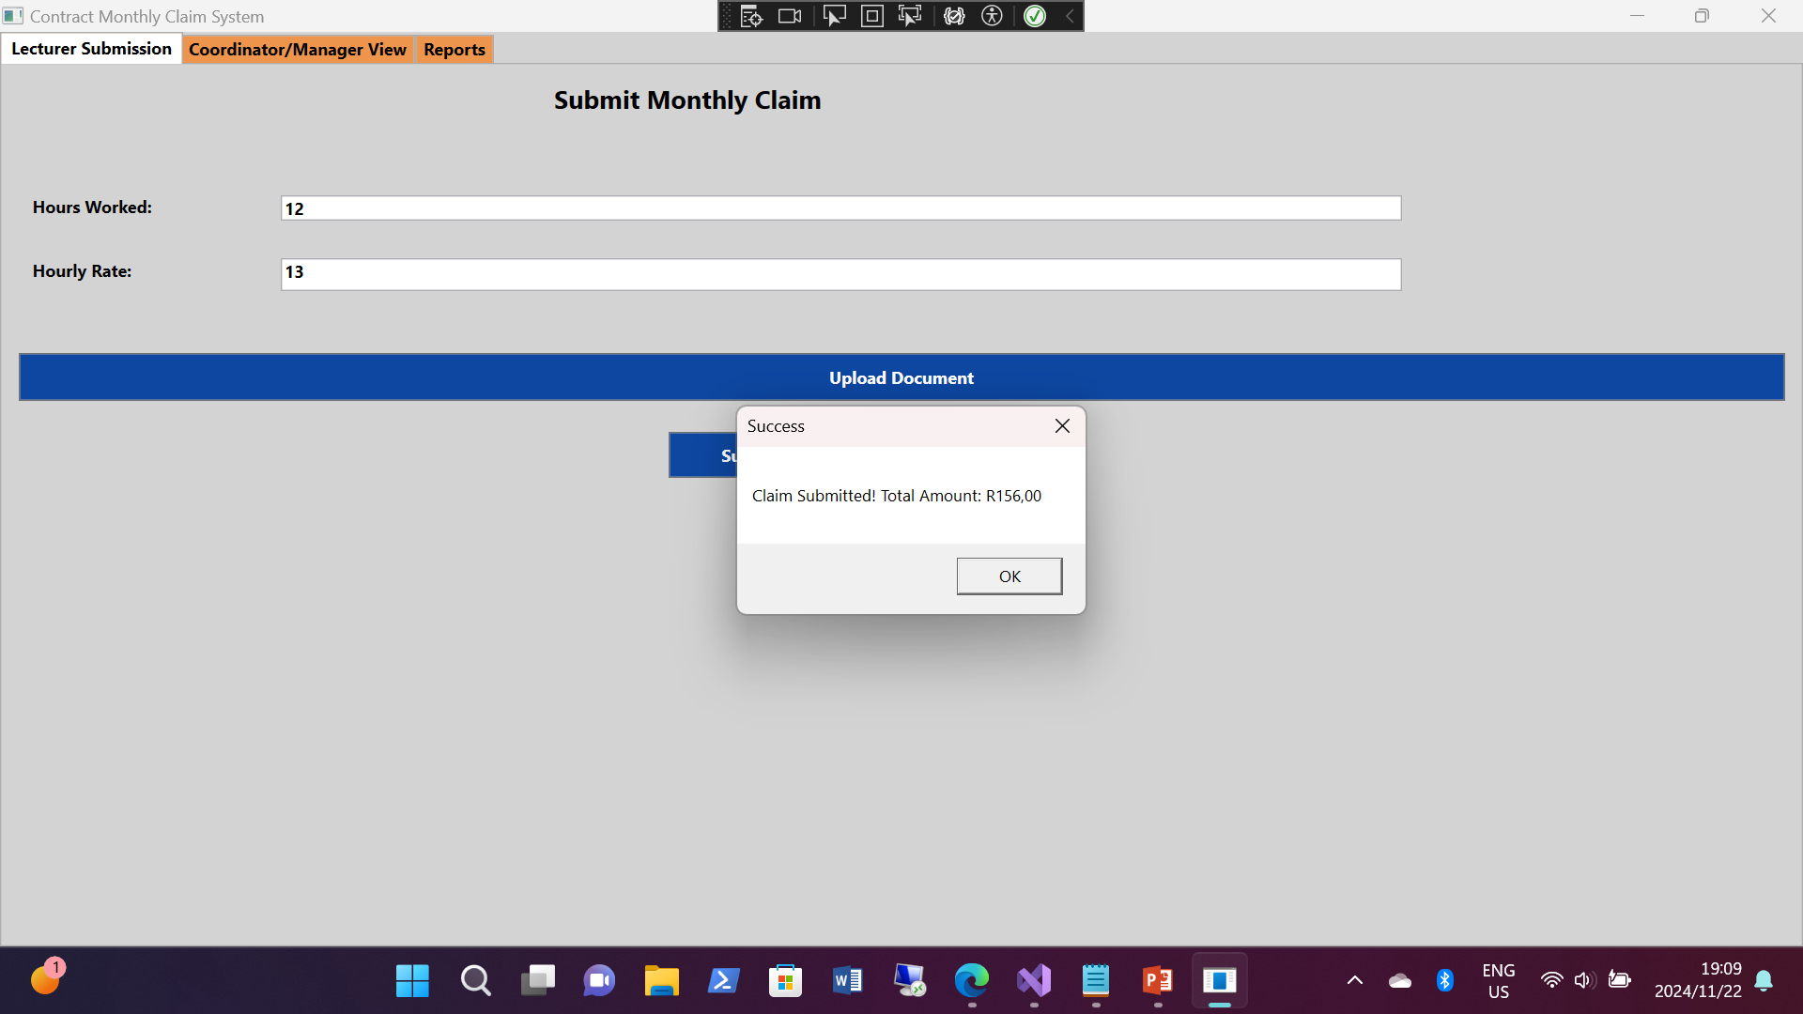
screenshots
Lecturer Submission Page:

Slide 10
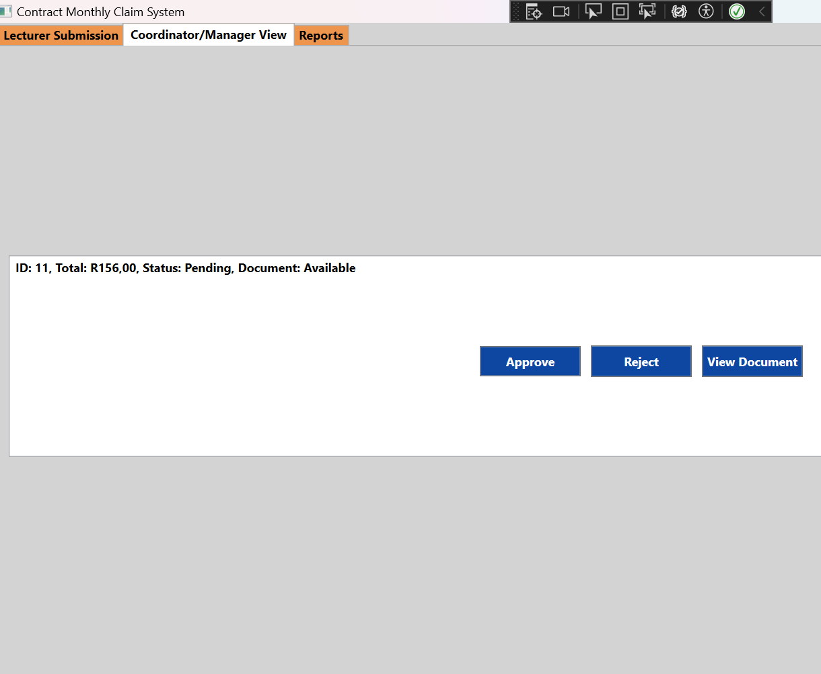
Screenshots: 2
Manager View:

Slide 11
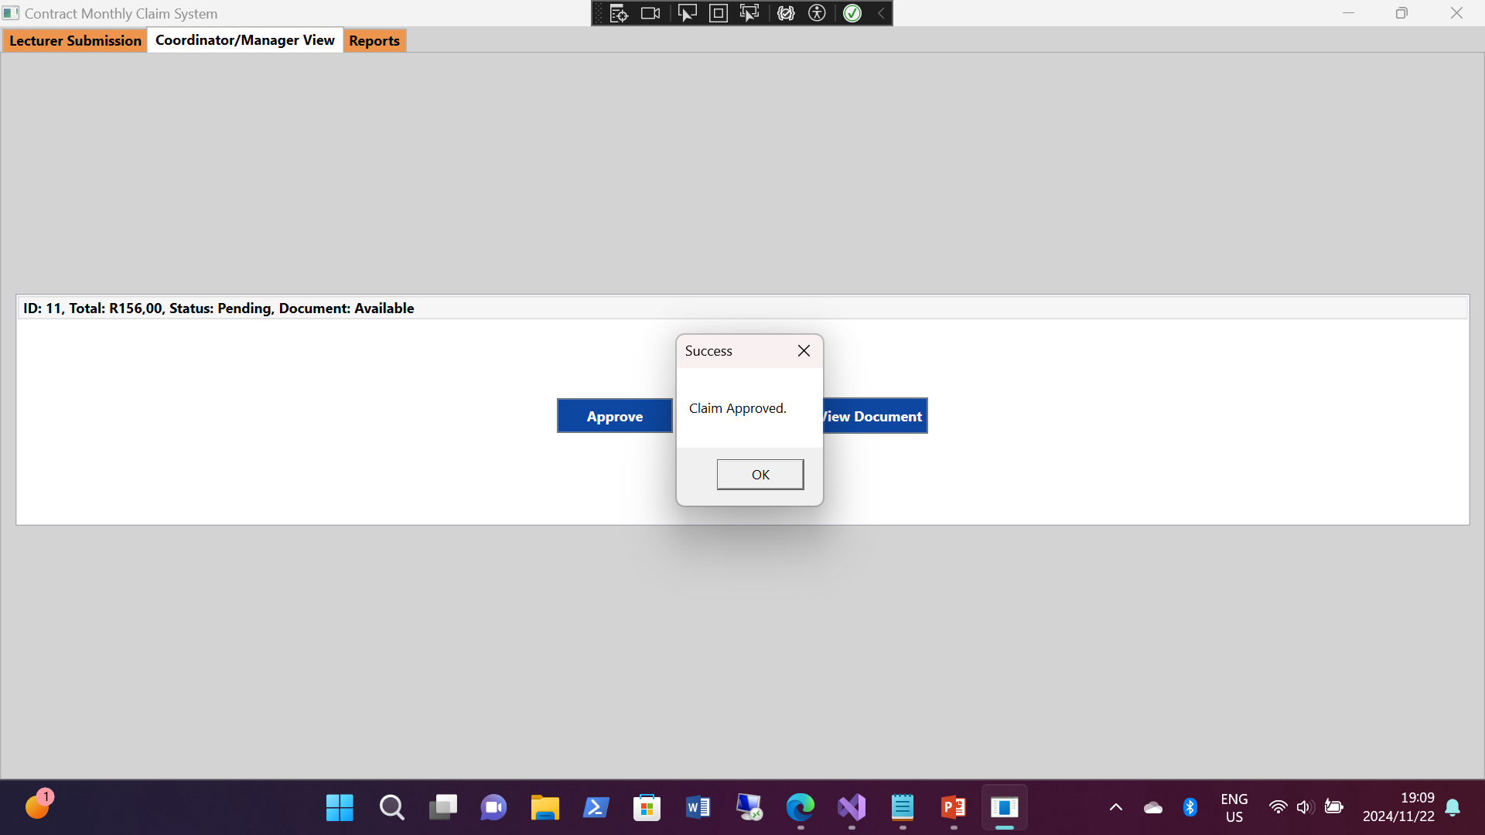
Screenshots: 2
Manager View:

Slide 12
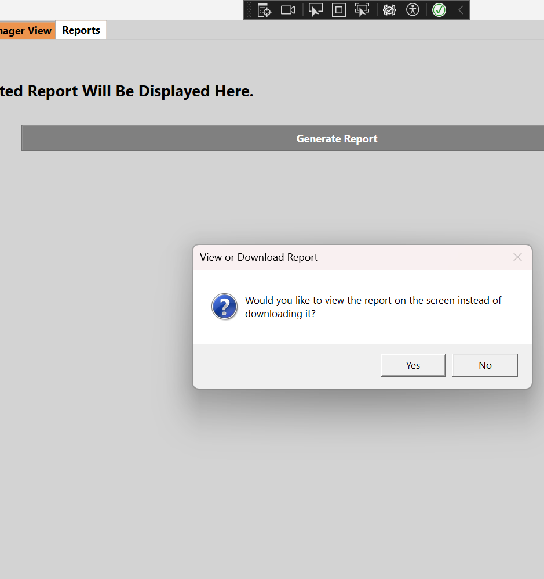
Screenshot: 3
HR Dashboard:

Slide 13
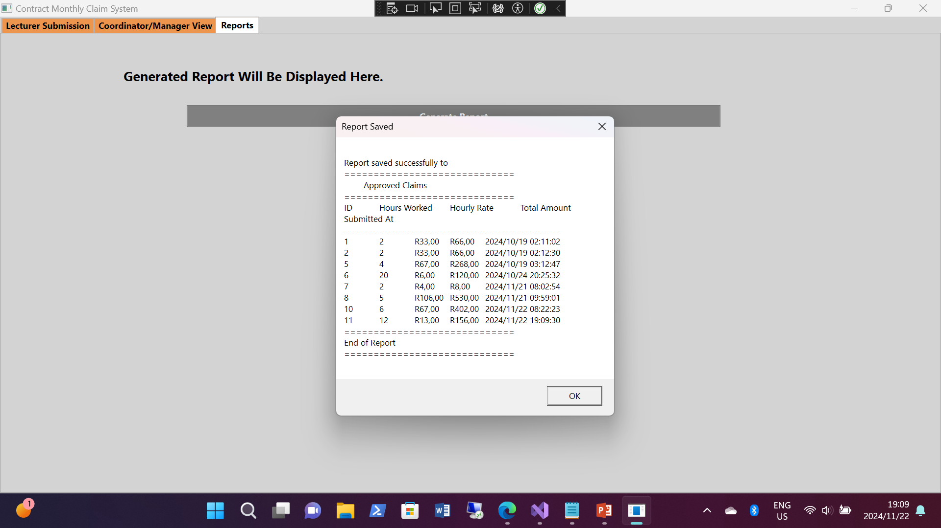
Screenshot: 3
HR Dashboard:

Slide 14
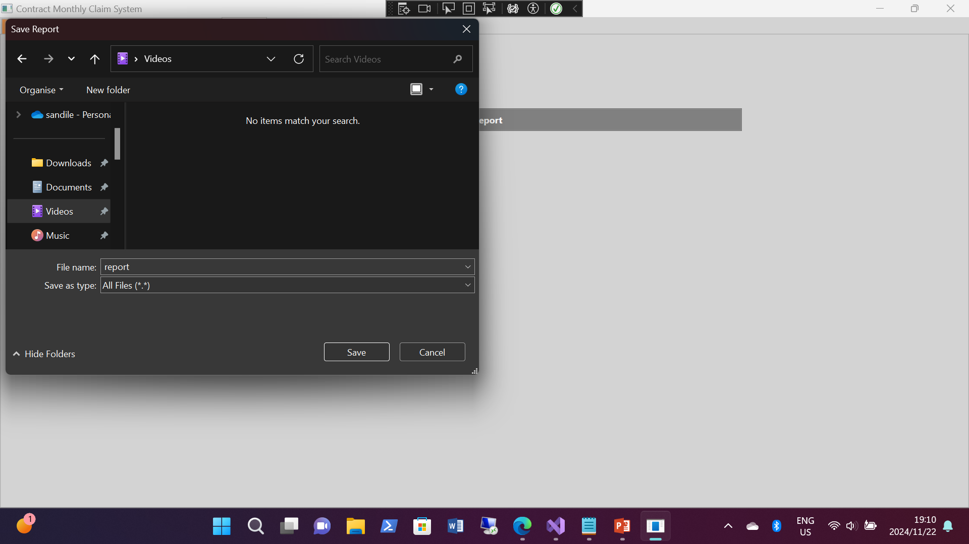
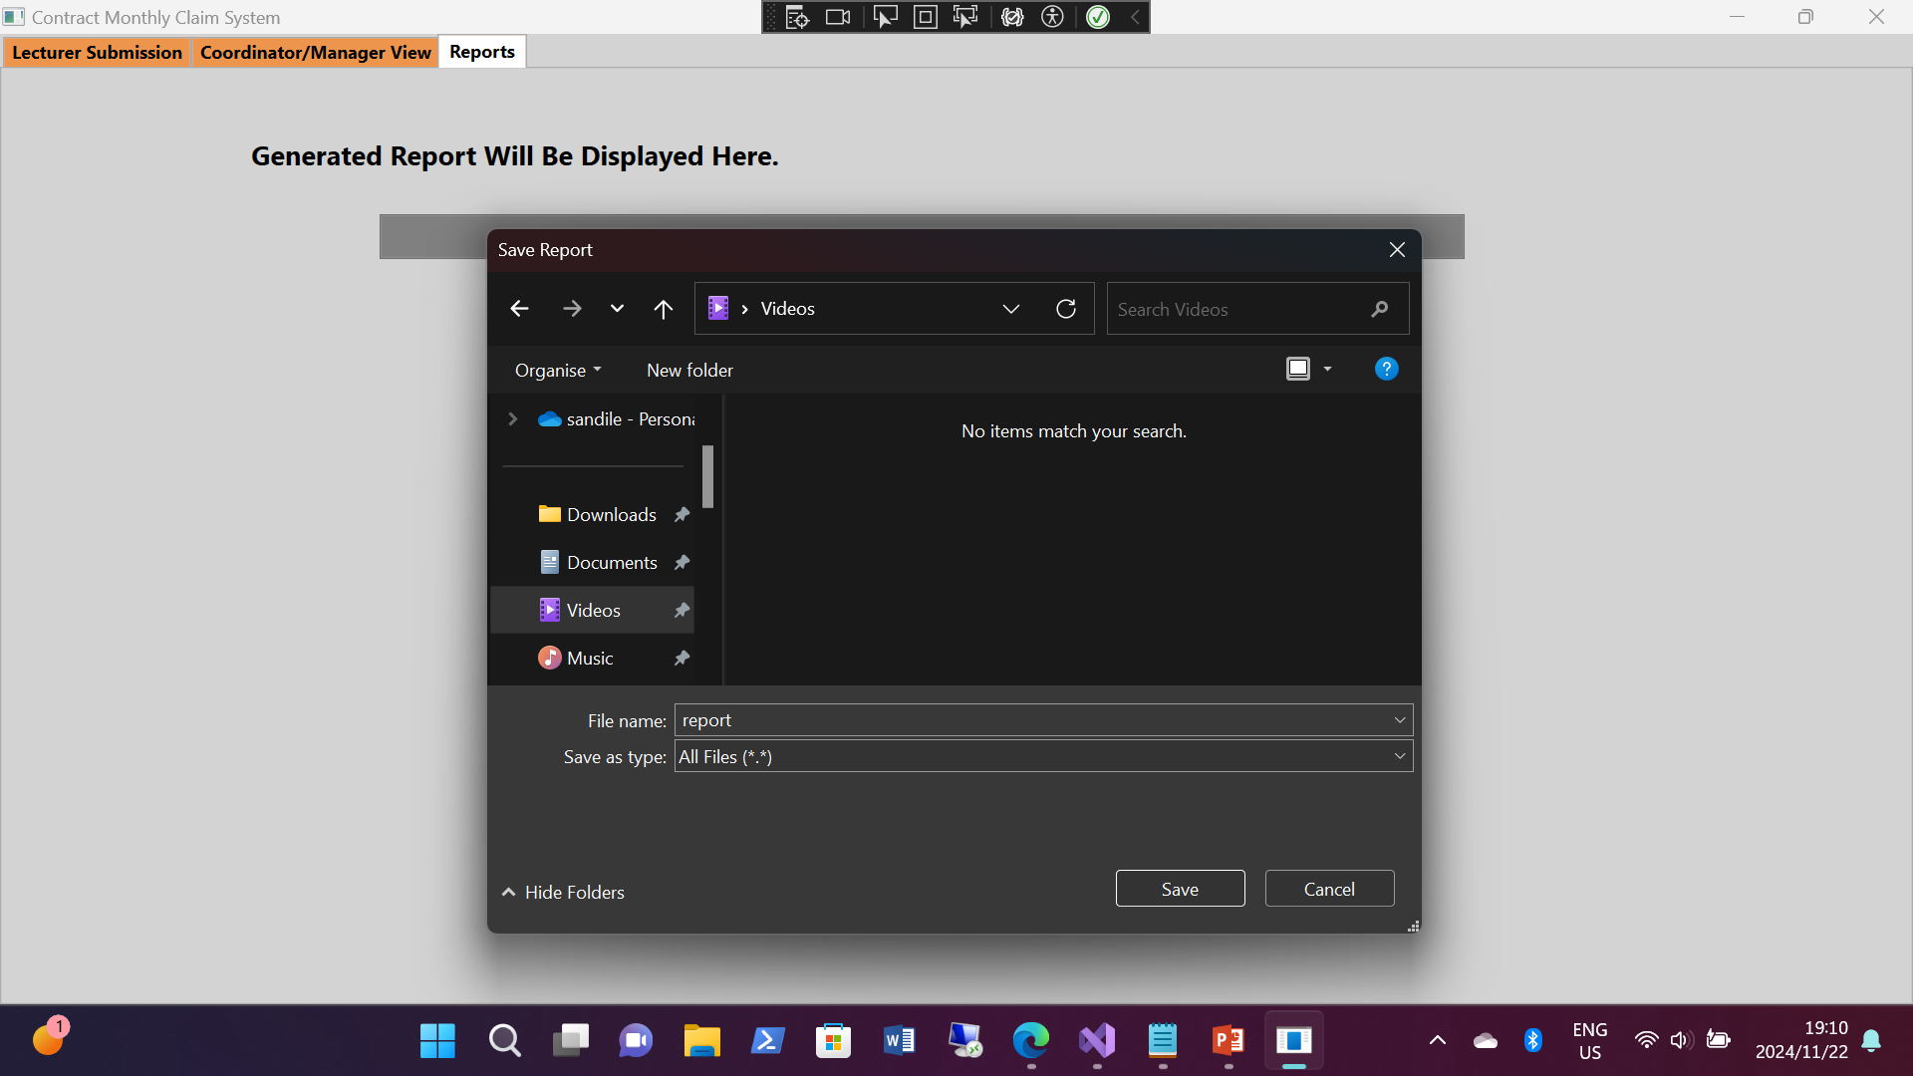
Screenshot: 3
HR Dashboard:

Slide 15
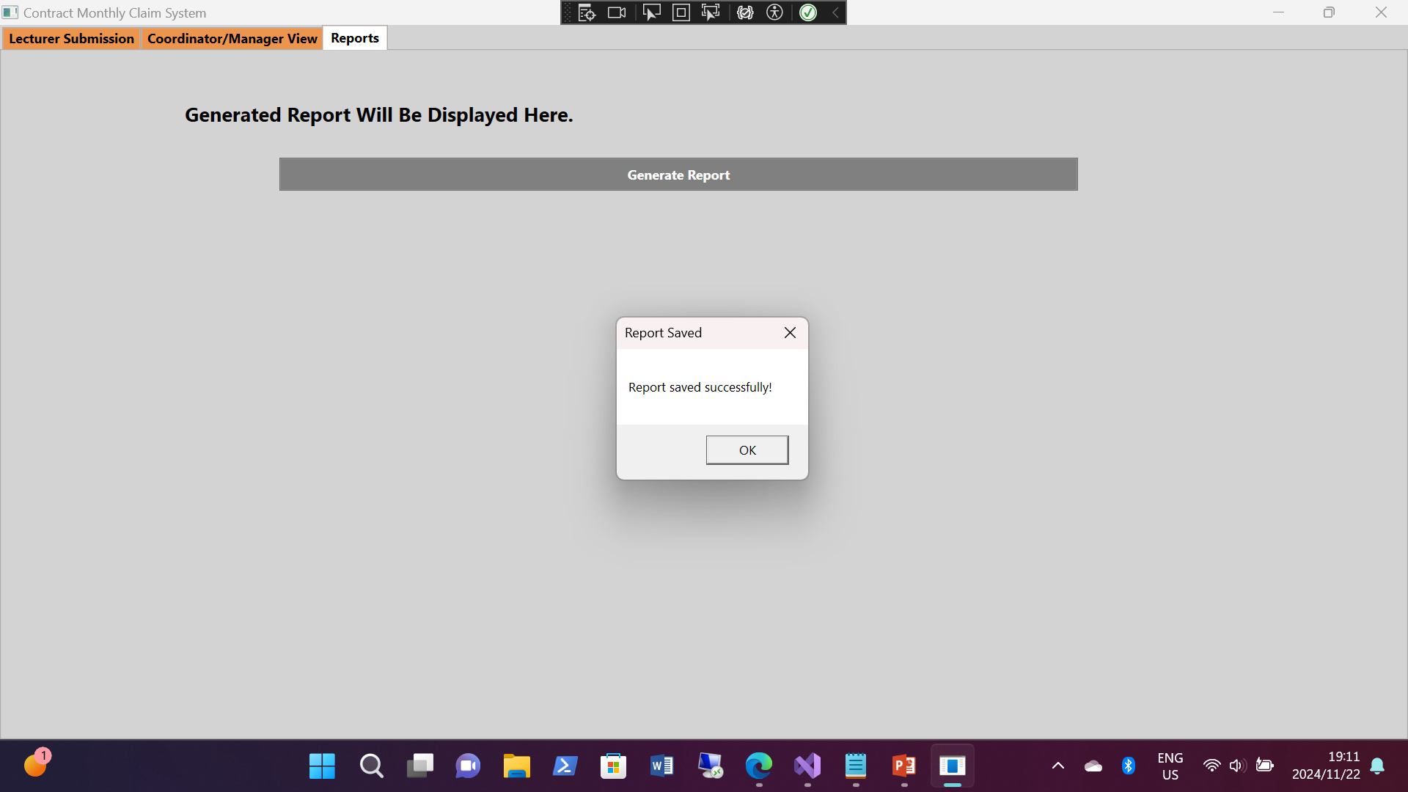
Screenshot: 3
HR Dashboard:

Slide 16
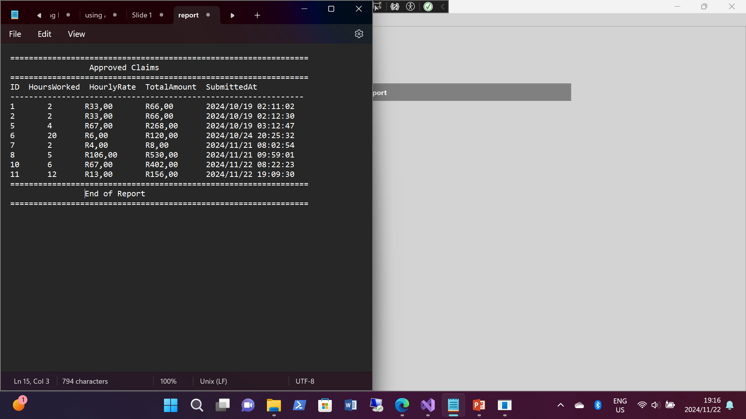
Screenshot: 3
HR Dashboard:

Slide 17
Future Enhancements
Scalability Plans:
Prepare the system for increased user load and data volume.
Additional Features:
Mobile application for on-the-go claim submissions.
Integration with existing HR systems for seamless data flow.
Enhanced reporting tools for better insights.

Slide 18
GitHub Repository
Repository Link:

Slide 19
Conclusion
The Contract Monthly Claim System aims to revolutionize the way claims are submitted and processed within the organization.
Value Proposition:
By enhancing efficiency and accuracy, the system not only benefits individual users but also contributes to the overall productivity of the organization.
Call to Action:
Encourage stakeholders to adopt the system and provide feedback for continuous improvement.

